Slide 1
Coding Basics
Part 1

Slide 2
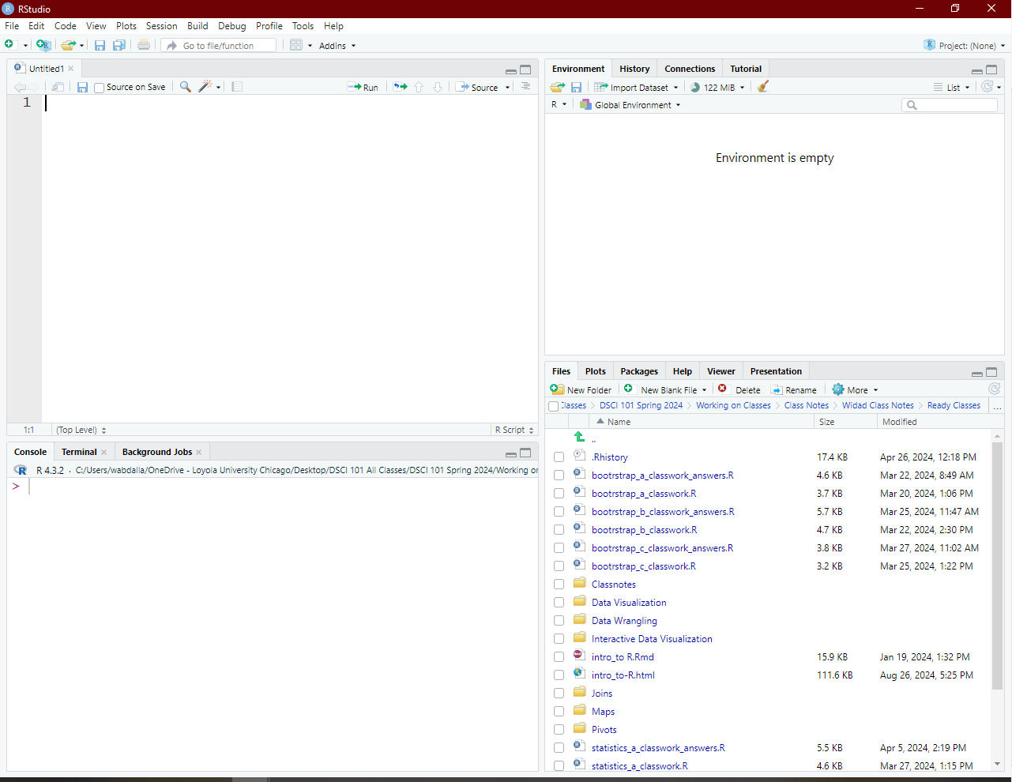
R & RStudio - Basic Components

Slide 4
Console Window
located in the bottom left.
It’s where you often will find the output of your coding and computations.
It is also possible to write code directly into the console.

Slide 6
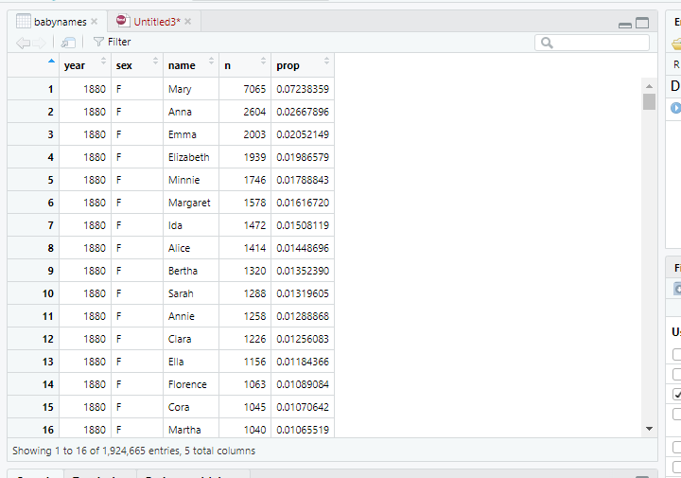
Source Window
Located in the top left.
“Source” can be understood as any type of file.
Function of the source window include:
  Inspect data in an Excel-like format.
  Open programming code and code editing.
  Run the analysis you have written.

Slide 7
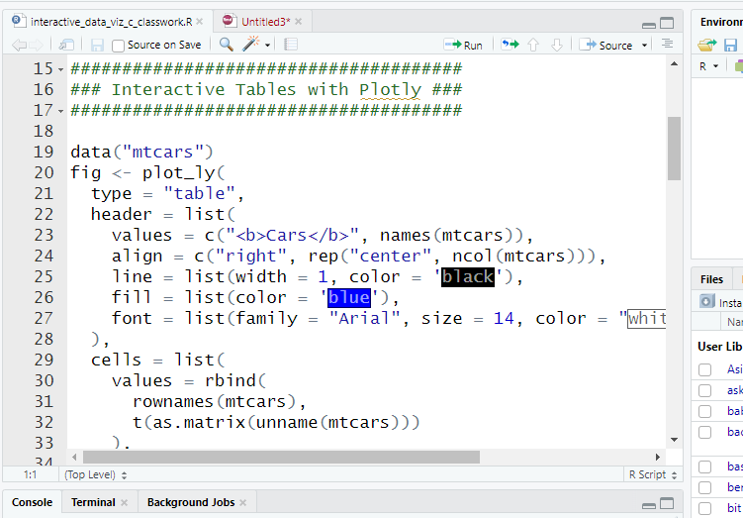
Source Window
Located in the top left.
“Source” can be understood as any type of file.
Function of the source window include:
  Inspect data in an Excel-like format.
  Open programming code and code editing.
  Run the analysis you have written.

Slide 9
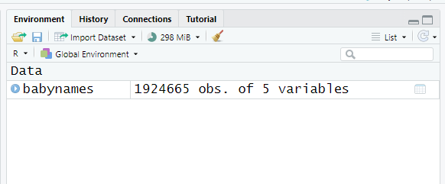
Environment/History/Connections/Tutorial Window
Located in the top-right.
Shows multiples panes, but the most important one is “Environment”.
Environment: shows you objects which are available for computation. Some examples of objects include:
    Dataset
    Vectors
    Matrices
    Lists
    Functions you create yourself.

Slide 11
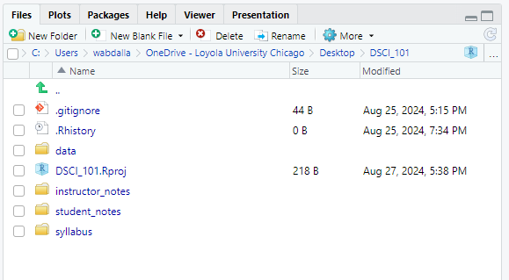
Files/Plots/Packages/Help/Viewer Window
Located in the bottom-right.
It consists of five essential panes:
Files pane: lists all the files and folders in your root directory.

Slide 12
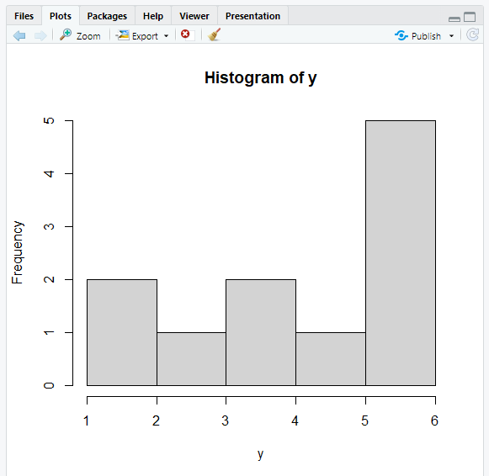
Plots pane: This pane is exclusively designed to show you any plots you have created using R.
  To delete a plot, you can click on the red circle with a white x symbol.
  To remove all plots, you can use the broom.
  There are options to export your plot and move back and forth between different plots.

Slide 13
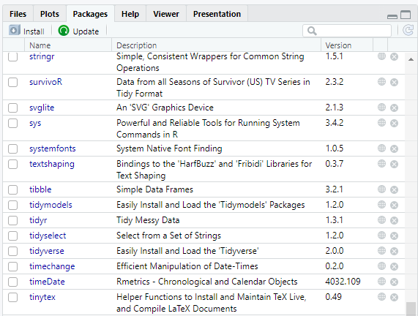
Packages: they are additional tools you can import and use when performing your analysis.
  A frequent analogy people use to explain packages is your phone and the apps you install. Each package you download is equivalent to an app on your phone.
  It can enhance different aspects of working in R, such as creating animated plots, or simply making your life easier by doing multiple computations with just one single line of code.

Slide 14
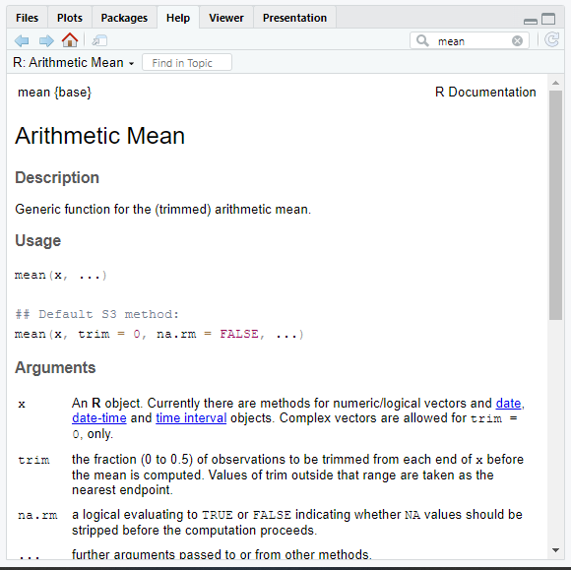
Help pane: you can search for specific topics, for example how certain computation works. The Help pane also had documentation on different datasets that are included in R, Rstudio or R packages you have installed.

Slide 15
Customize your Interface
Go to Tools > Global Options > Appearance

Slide 16
Packages
Many of R’s most useful functions do not come preloaded when you start R, but reside in packages that can be installed on top of R.
An R package bundles together useful functions, help files, and data sets.
You can use these functions within your own R code once you load the package they live in.
You only need to install a package once in your computer.
code:
You need to load the package every time you open R.
code:

Slide 17
File Types
R Script
  Extension: .R
  This is a file you can write your codes in it.
RMarkdown Script
  Extension: .Rmd
  Incorporates code and texts together to knit a document together.
  Knitting an rmd file compiles the text and code together to create another file such as an .html or .pdf

Slide 18
File Types
R Project
  Extension: .Rproj
  Helps you organize your different coding projects.
  The working directory will automatically be set to the directory that the .RProj file is located in allowing easier organization and access to your data and files.

Slide 19
Data Structure
Data Structure is a specific way to organize, store, process, and retrieve your data.
Vectors
Examples of vectors:
[4, 1, 3, 8, 6, 7, 5, 3, 0, 9]
Code:

Slide 20
[1, 2, 3, 4, 5, 6, 7, 8, 9, 10]
Code:
[x.1, x.2, x.3, x.4, x.5]
Code:

Slide 21

Matrices
Examples:
  $\left[\begin{matrix}4 & 6 \\ 7 & 8 \\ 9 & 10\end{matrix}\right]$
code:

Slide 22

$\left[\begin{matrix}1 & 2 & 3 \\ 4 & 5 & 6 \\ 7 & 8 & 9\end{matrix}\right]$
code:

